Slide 1
Digital Image Processing Technologies & Applications
Representation & Description

Slide 2
Contents
This lecture will cover:
Boundary Descriptors
Region descriptor
Some simple descriptor
Topological descriptor
Texture
Moments of two-dimensional function
Color descriptor

Slide 3
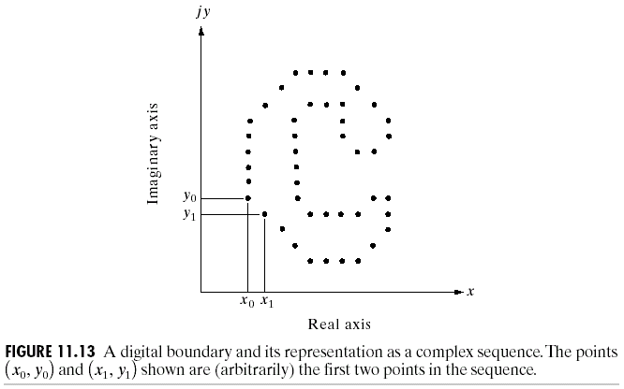
Fourier Descriptors
boundary = (x₀,y₀), … , (x_{K-1},y_{k-1})
Map 2D function to 1D function

Slide 4
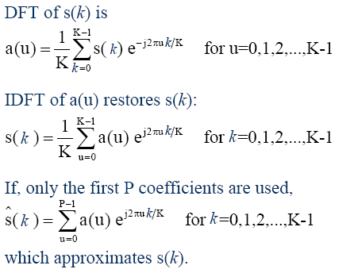
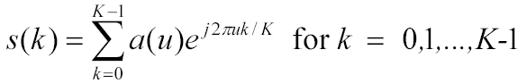
Fourier Descriptors
We call a(u) is the
Fourier descriptor

Slide 5
Fourier Descriptors
The same number of points exists in the approximate boundary, but not as many terms are used in the reconstruction of each points.
We know that high frequency components account for fine detail, and low frequency components determine global shape.
Thus the smaller p becomes the more detail that is lost on the boundary.

Slide 6
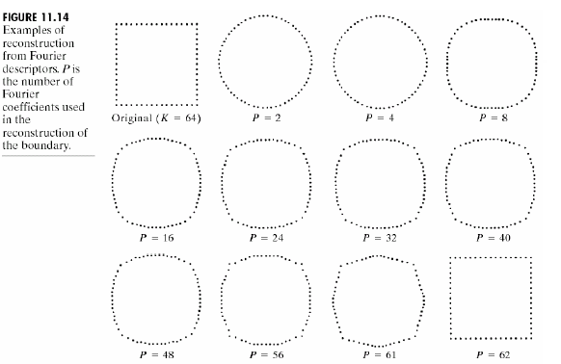
Fourier Descriptors
结论：低阶系数能够反映大体形状，高阶系数可以精确定义形状特征，少数傅里叶描述子携带了形状信息，能够反映边界的大略本质。

Slide 7
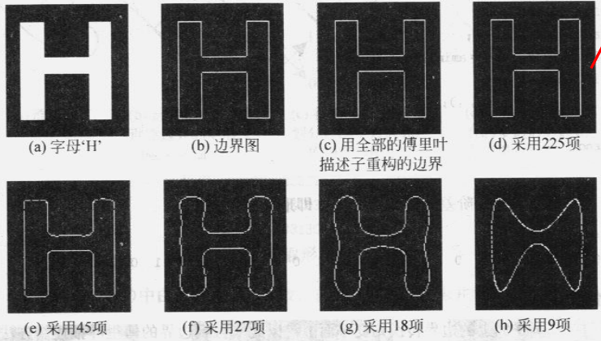
Fourier Descriptors
50% coefficients

Slide 8
Regional Descriptors
Some simple descriptor
Topological descriptor
Texture
Moments of two-dimensional function

Slide 9
Simple Descriptors
Area = the number of pixels in the region
Perimeter = length of its boundary
Compactness = (perimeter)²/area
Other simple measures used as region descriptor includes: the mean and median of the gray levels, the minimum and maximum gray levels, and the number of pixels with values above or below the mean.
Compactness=(2*pi*r) ²/pi*r²=4pi
Compactness=(4*a) ²/a²=16

Slide 10
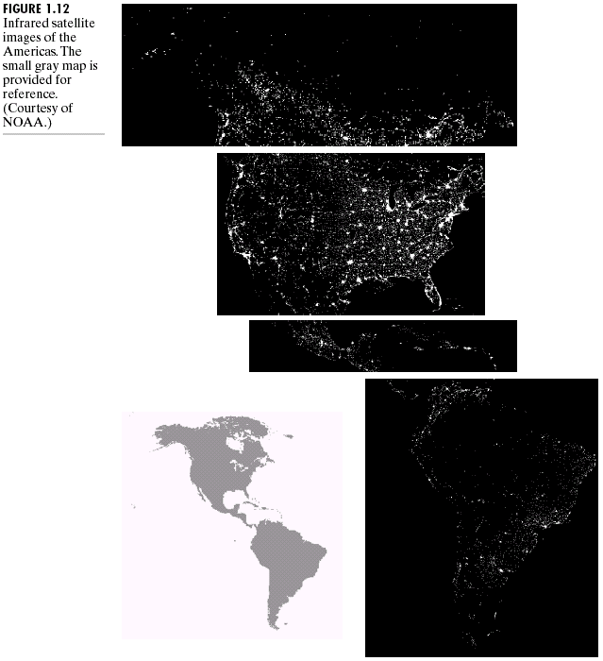
Simple Descriptors
Even simple region descriptor such as normalized area can be quite useful in extracting information from images.
Region No. (From top) | Ratio of light per region to total lights
1 | 0.204
2 | 0.640
3 | 0.049
4 | 0.107

Slide 11
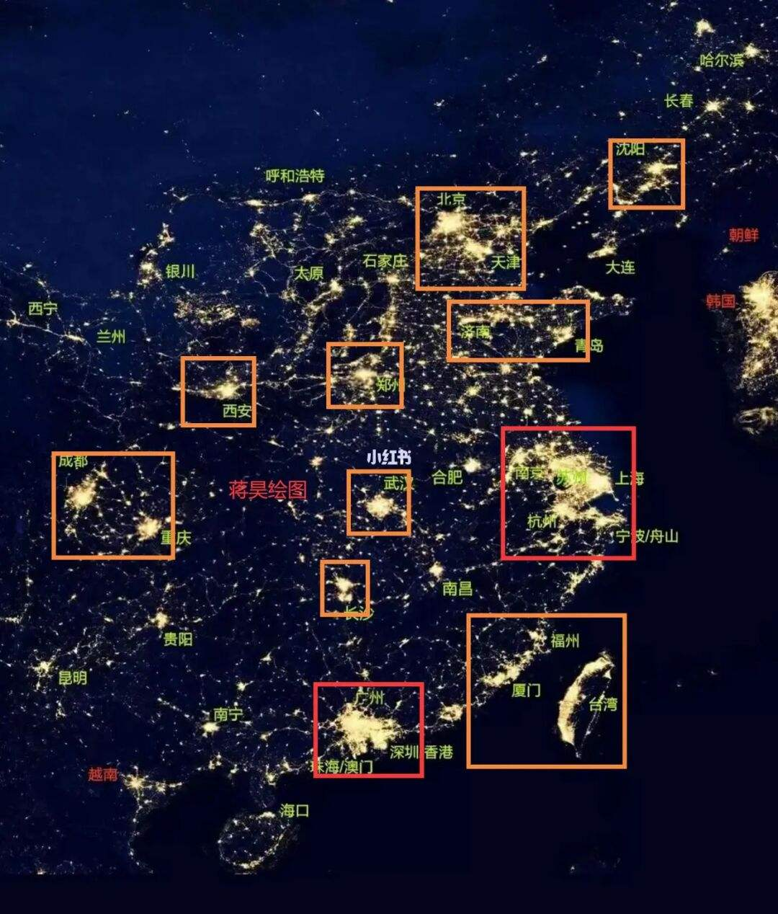
Simple Descriptors
https://www.xiaohongshu.com/explore/6325d0130000000008029f66

Slide 12
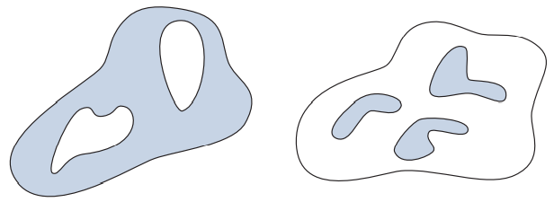
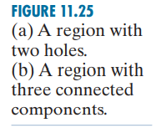
Topological Descriptors
Topological properties are useful for global description of regions in the image plane.
Simply defined, topology is the study of properties of a figure that are unaffected by any deformation, as long as there is no tearing or joining of the figure.
Topological descriptors can be defined by the number of holes and connected components in the region.

Slide 13
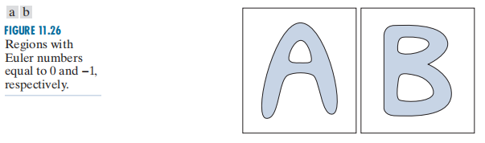

Topological Descriptors
Euler number E:
E=C-H, where C is the no. of connected components, H is the no. of holes

Slide 14
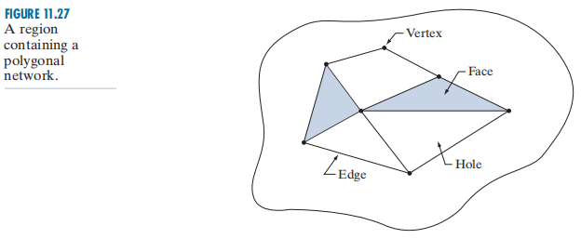
Topological Descriptors
Denoting the number of vertices by V, the number of edges by Q, and the number of faces by F gives the following relationship, called the Euler formula:
which can be expressed as
The network has 7 vertices, 11 edges, 2 faces, 1 connected region, and 3 holes, thus the Euler number is −2.

Slide 15
Topological Descriptors
Euler number: –1，2，1 ， 0

Slide 16
Texture Descriptors
An important approach to region description is to quantify its texture content.
Now no formal definition of texture exists.
Texture is a set of primitive patterns in some regular or repeated relationship, or have similar properties such as constant color, gray level, average intensity, etc...
Coarse textures are built from larger primitive patterns; Fine textures from smaller primitive patterns.
Texture descriptor provides measures of properties such as smoothness, coarseness, and regularity.
Notes:
纹理可认为是灰度（颜色）在空间以一定的形式变化而产生的图案（模式）
纹理由许多相互接近的、互相编织的元素构成（它们常富有周期性）
纹理与尺度有密切联系：任何物体的表面，如果一直放大下去进行观察的话一定会显现出纹理
纹理具有区域性质的特点：对单个象素来说讨论纹理是没有意义的，纹理可用来辨识图象中的不同区域

Slide 17
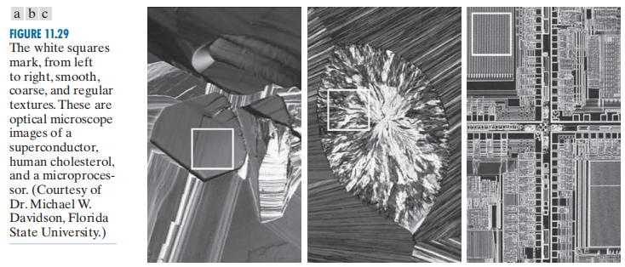
Texture

Slide 18


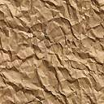
Texture
(a)
(b)
(a) Artificial texture （b）Nature texture

Slide 19
Texture
There are three principal approaches used in texture analysis:
Statistical approaches
Moments of the gray level histogram
Gray level co-occurrence matrix
Structural approaches
Statistical: convenient for natural textures.
Structural: convenient for artificial textures.

Slide 20
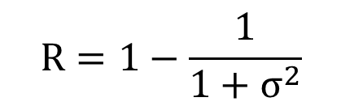
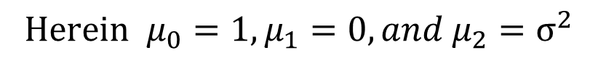
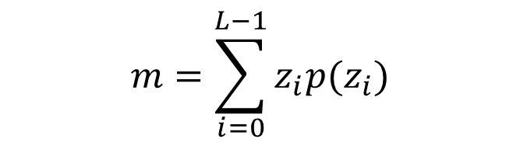
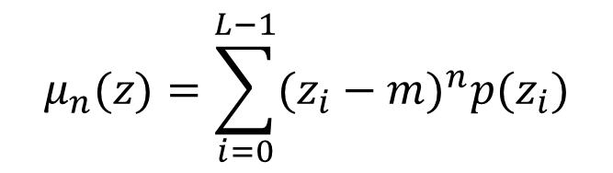
Texture
Statistical approaches:
Let z be a random variable denoting gray levels and let $p(z_{i}),i=1,2,...L−1,$be the corresponding histogram. The $n^{th}$ moment of z about the mean is
$$μ_{n}(z)=\sum_{i=0}^{L−1}{{(z_{i}−m)}^{n}p(z_{i})}$$
$$m=\sum_{i=0}^{L−1}{z_{i}p(z_{i})}$$
$${Herein μ}_{0}=1,μ_{1}=0, and μ_{2}=σ^{2}$$
$$R=1−\frac{1}{1+σ^{2}}$$
The measure of gray-level contrast:
R is 0 for the area of constant intensity (the variance is zero here), and approaches 1 for large value of $σ^{2}$

Slide 21
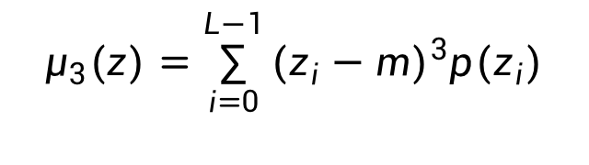
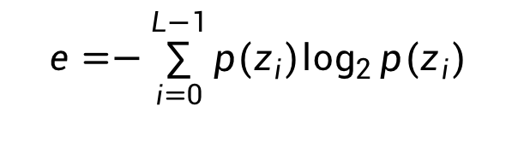
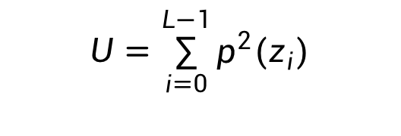
Texture
The third moment,
$$μ_{3}(z)=\sum_{i=0}^{L−1}{{(z_{i}−m)}^{3}p(z_{i})}$$
is a measure of the skewness of the histogram.
The fourth moment is a measure of relative flatness. Some additional texture measures based on histograms:
$$U=\sum_{i=0}^{L−1}{p^{2}(z_{i})}$$
“unitformity”
$$e=−\sum_{i=0}^{L−1}{p(z_{i})\log_{2}{p(z_{i})}}$$
“average entropy”
Notes:
skewness
n. 歪斜

Slide 22
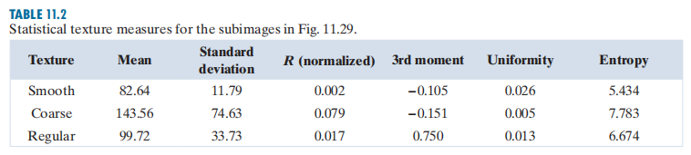
Texture

Slide 23
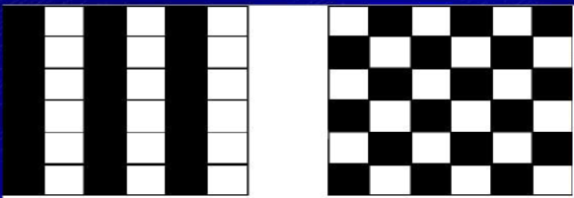
Gray Level Co-occurrence Matrix
Measures of texture computed using only histograms suffer from the limitation that they carry no information regarding the relative position of pixels with respect to each other.
Gray level co-occurrence matrix: a way is to consider not only the distribution of intensities, but also the positions in texture analysis.
Images with same histograms
Notes:
co-occurrence matrix
共生矩阵

Slide 24
Gray Level Co-occurrence Matrix
A co-occurrence matrix, also referred to as a co-occurrence distribution, is defined over an image to be the distribution of co-occurring values at a given offset.
Let f(x,y) be a gray level image, then the co-occurrence matrix C_{P} is defined as follows:
The value of C_{p}(i,j) indicates how many times value i co-occurs with the value j in some designed spatial relationship.

Slide 25
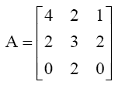
Gray Level Co-occurrence Matrix
Consider an image with three levels, z₁=0, z₂=1 and z₃=2
Defining a position operator P as “one pixel to the right and one pixel below” yields the following 3×3 matrix A:
f(m,n)=
For a₁₁: 表示灰度为 z₁=0 的点出现在灰度为 z₁=0 的点右下方的次数。
For a₁₃: 表示灰度为 z₁=0 的点出现在灰度为 z₃=2 的点右下方的次数。

Slide 26
Gray Level Co-occurrence Matrix
Notes:
The size of C is determined by the number of distinct gray levels in the input image.
C also depends on the position operator P, the presence of given texture patterns may be detected by choosing an appropriate position operator.
For instance, the operator used in the first example is sensitive to bands of constant intensity running at -45 degree.

Slide 27

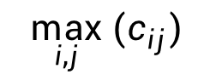
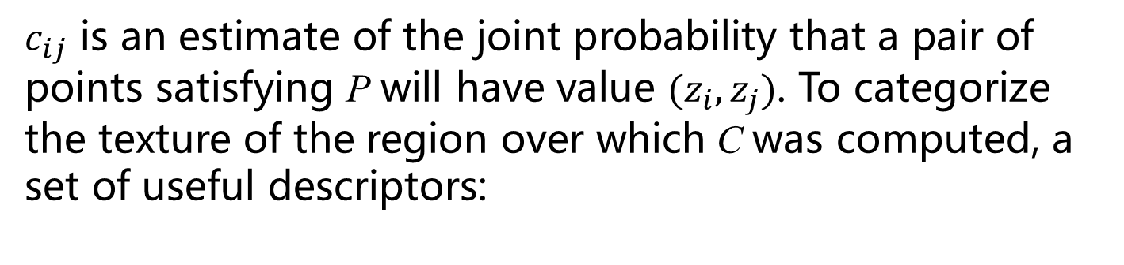
Gray Level Co-occurrence Matrix
Let n be the total number of point pairs in the image that satisfies P(n=16, the sum of all values in matrix A). Then the gray-level cooccurrence matrix C is formed by dividing every element of A by n
$c_{ij}$ is an estimate of the joint probability that a pair of points satisfying P will have value $(z_{i},z_{j})$. To categorize the texture of the region over which C was computed, a set of useful descriptors:
1.Maximum probability
$$\max_{i,j}{(c_{ij})}$$
(The strongest response to P)
2.Element difference moment of order K
$$\sum_{i}{\sum_{j}{{(i−j)}^{k}c_{ij}}}$$
(Contrast)

Slide 28
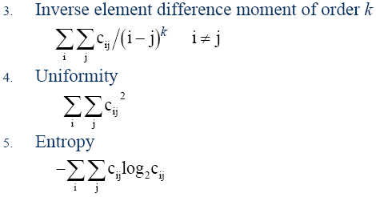
Gray Level Co-occurrence Matrix
逆元素差异的k阶矩：度量图像纹理局部变化的多少，局部约均匀，值越大。
Uniformity：图像越均匀，值越大。
Entropy：图像灰度级随机性越大（纹理越粗糙），值越大。
6. Correlation
Correlation：描述灰度共生矩阵中行或列元素之间的相似程度，越相似值越大。

Slide 29
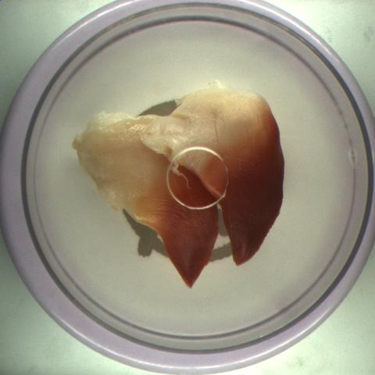
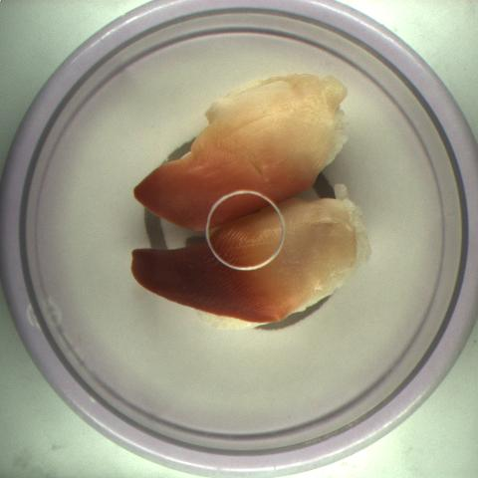
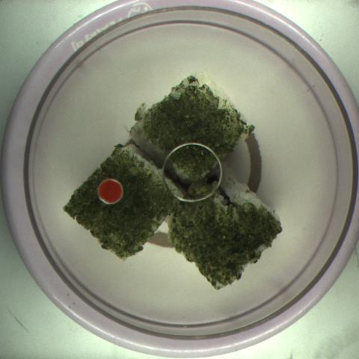
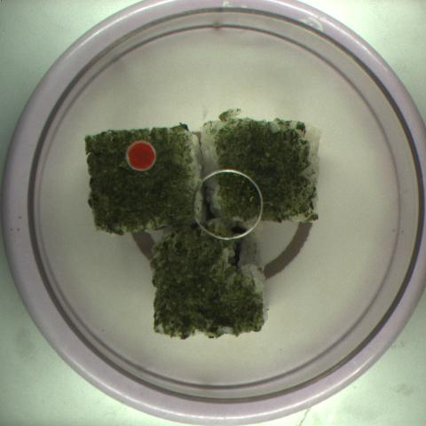
Gray Level Co-occurrence Matrix
 | Uniformity | Contrast | Entropy | Correlation
北极贝1 | 0.187987 | 0.154038 | 2.884064 | 128793.00
北极贝2 | 0.186849 | 0.170735 | 2.833209 | 110430.60
波士顿卷1 | 0.242909 | 0.237909 | 2.763094 | 15112.86
波士顿卷2 | 0.238401 | 0.218485 | 2.781281 | 18795.74

Slide 30
Texture
a
aaaaa…
Add new rules to let the circle move left, and down.
aaaaaabcccccbaaaaabcccccbaaaaa
Texture primitive(图元) can be used to form complex texture patterns by means of some rules
Suppose we have a rule of the form S->aS, which indicates that the symbol S may be rewritten as aS
b: circle down; c:circle to the left

Slide 31
Moments of Two Dimensional Functions
Moments can be used to represent the geometrical characters in image. It is also called moment invariants, because it is insensitive to rotation, translation, and scale.
Moment invariants (proposed by Hu in 1965 in paper: Visual pattern recognition by moment invariants.

Slide 32
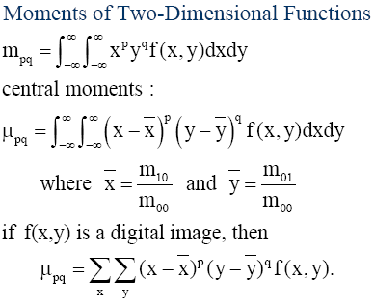
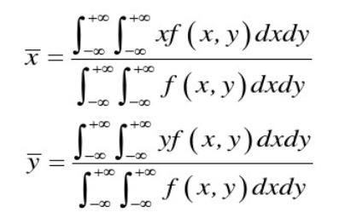
Moments of Two Dimensional Functions
p+q order moments

Slide 33
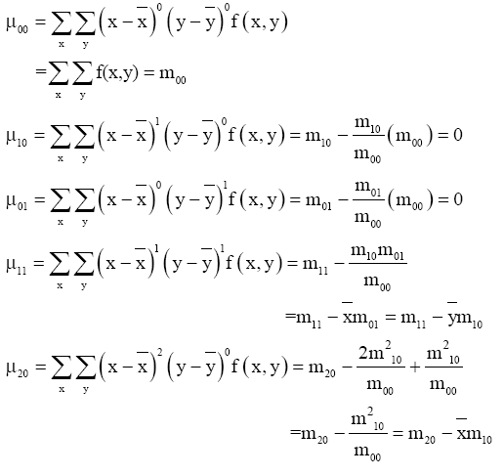

Moments of Two Dimensional Functions

Slide 34
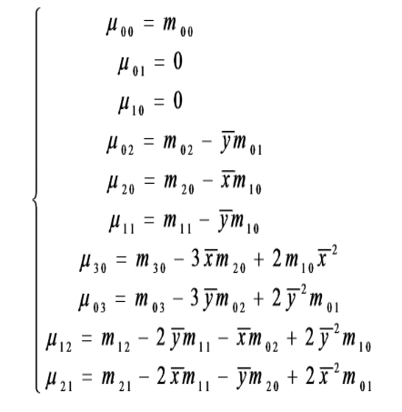
Moments of Two Dimensional Functions
Three order central moments:

Slide 35
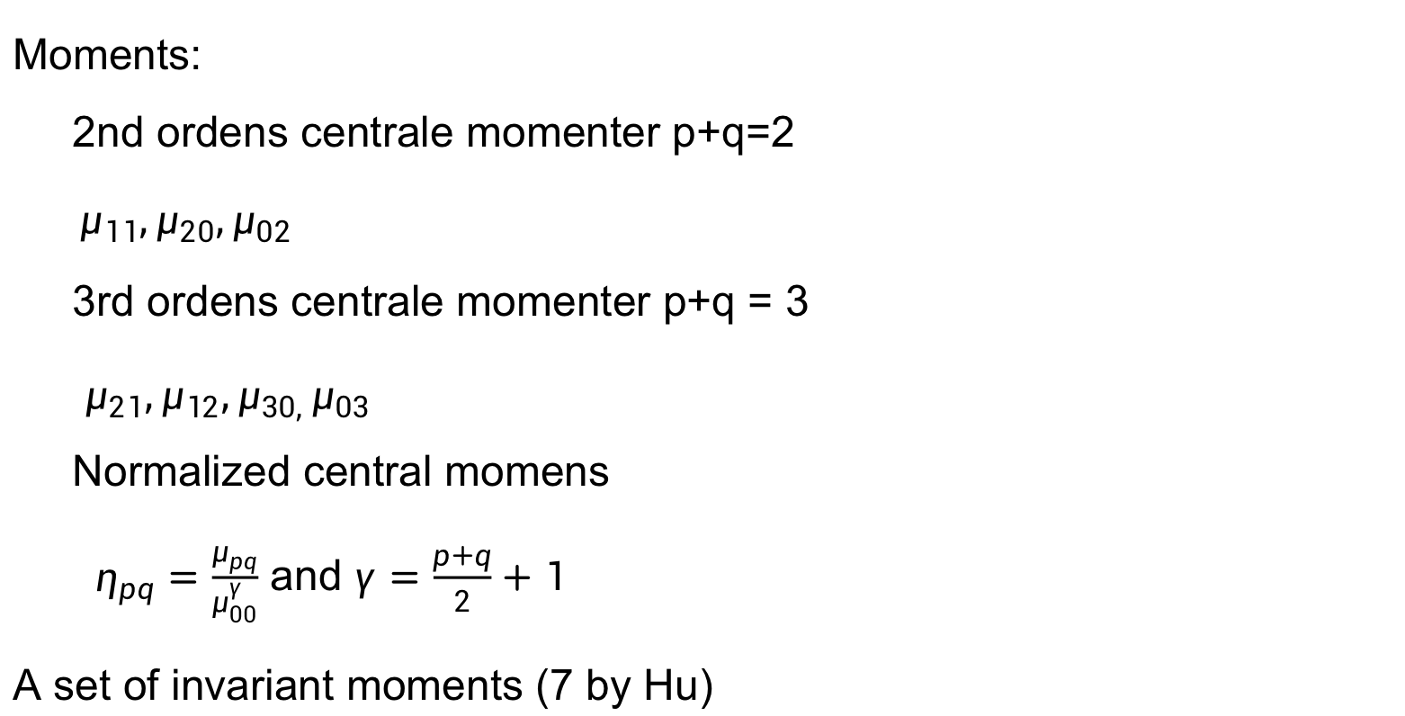
Moments of Two Dimensional Functions
Moments:
2nd ordens centrale momenter p+q=2
$μ_{11},μ_{20},μ_{02}$
3rd ordens centrale momenter p+q = 3
$μ_{21},μ_{12},μ_{30, }μ_{03 }$
Normalized central momens
$η_{pq}=\frac{μ_{pq}}{μ_{00}^{γ}}$ and $γ=\frac{p+q}{2}+1$
A set of invariant moments (7 by Hu)

Slide 36
Moments of Two Dimensional Functions
This set of moments is invariant to translation, rotation, and scale change!!!

Slide 37
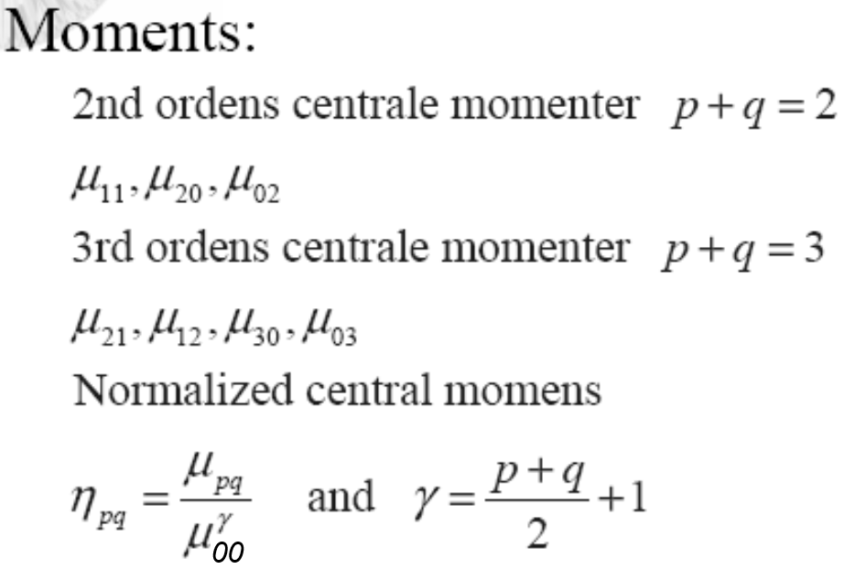
Code of Hu’s Moment
function HuF = Hu_moment(image)
image=double(image);
m00=sum(sum(image));
m10=0;m01=0;m11=0;m20=0;m02=0;m21=0;m12=0;m30=0;m03=0; ux=0;uy=0;
[row,col]=size(image);
for i=1:row
for j=1:col
m10=m10+i*image(i,j);
m01=m01+j*image(i,j);
m11=m11+i*j*image(i,j);
m20=m20+(i*i)*image(i,j);
m02=m02+(j*j)*image(i,j);
m21=m21+(i*i)*j*image(i,j);
m12=m12+i*(j*j)*image(i,j);
m30=m30+(i*i*i)*image(i,j);
m03=m03+(j*j*j)*image(i,j);
end
end
ux=m10/m00; uy=m01/m00;
n00=m00;
n10=0;
n01=0;
n11=m11-uy*m10;
n20=m20-ux*m10;
n02=m02-uy*m01;
n30=m30-3*ux*m20+2*ux*ux*m10;
n03=m03-3*uy*m02+2*uy*uy*m01;
n21=m21-2*ux*m11-uy*m20+2*ux*ux*m01;
n12=m12-2*uy*m11-ux*m02+2*uy*uy*m10;
n11=n11/m00^2;
n20=n20/m00^2;
n02=n02/m00^2;
n30=n30/m00^2.5;
n03=n03/m00^2.5;
n12=n12/m00^2.5;
n21=n21/m00^2.5;
h1 = n20 + n02;
h2 = (n20-n02)^2 + 4*(n11)^2;
h3 = (n30-3*n12)^2 + (3*n21-n03)^2;
h4 = (n30+n12)^2 + (n21+n03)^2;
h5 = (n30-3*n12)*(n30+n12)*((n30+n12)^2-3*(n21+n03)^2)+(3*n21-n03)*(n21+n03)*(3*(n30+n12)^2-(n21+n03)^2);
h6 = (n20-n02)*((n30+n12)^2-(n21+n03)^2)+4*n11*(n30+n12)*(n21+n03);
h7 = (3*n21-n03)*(n30+n12)*((n30+n12)^2-3*(n21+n03)^2)+(3*n12-n30)*(n21+n03)*(3*(n30+n12)^2-(n21+n03)^2);
HuF= [h1 h2 h3 h4 h5 h6 h7];

Slide 38
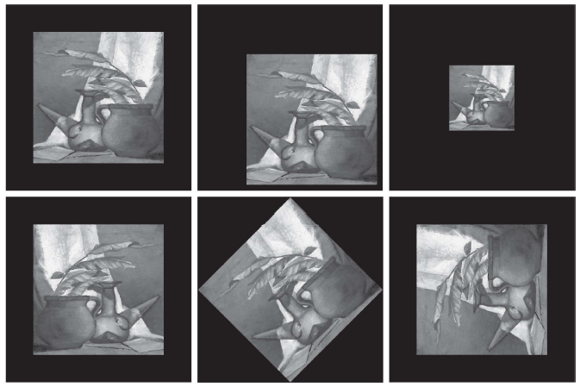
Moments of Two Dimensional Functions
(a) Original image. (b)-(f) Images translated, scaled by one-half, mirrored, rotated by 45 and rotated by 90 respectively.

Slide 39
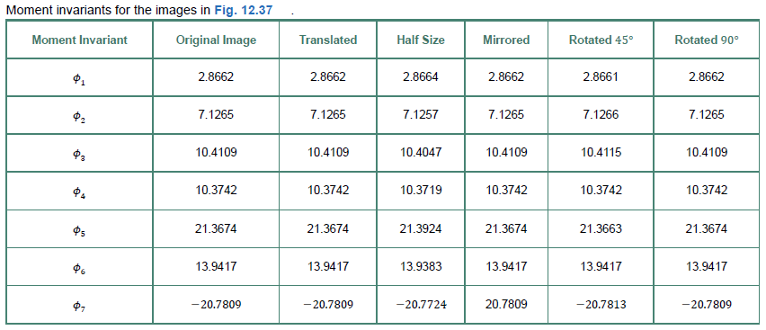
Moments of Two Dimensional Functions

Slide 40
Color descriptors
Color histogram descriptor
A color histogram is a 3D entity where each pixel of an image (rather than each sample) is placed into a bin.
The color space is divided into volumetric bins each of which represent a range of colors.
Each axis of the color space may be divided independently of the others. This allows the axes to have different resolutions.
In RGB may want to allocation more resolution in G than R or B
In YCbCr may want to allocate more resolution on Y than Cb or Cr

Slide 41
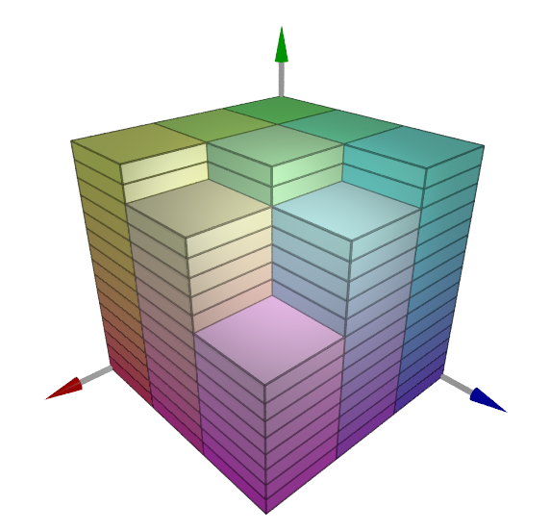
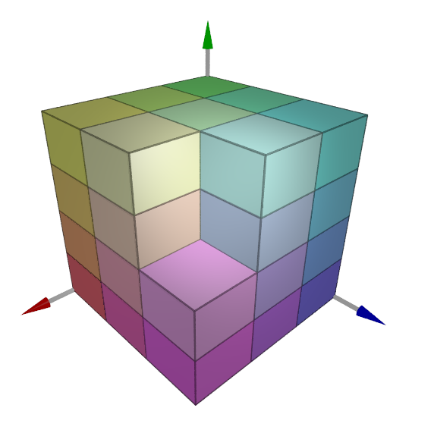
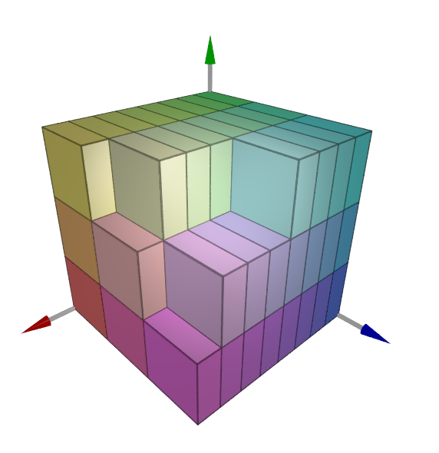
Color descriptors
3x15x3 resolution
3x4x3 resolution
8x3x3 resolution
Consider the resolution of various color histogram bins in RGB space. The resolution of each axis may be set independently of the others.

Slide 42
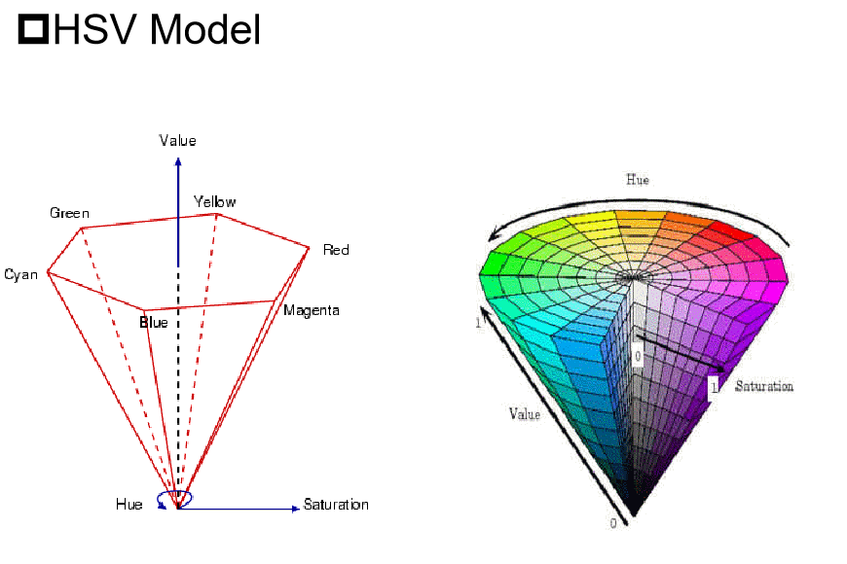
Color descriptors

Slide 43
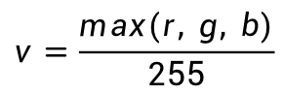
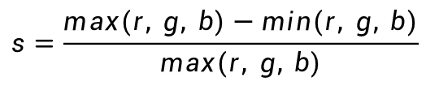
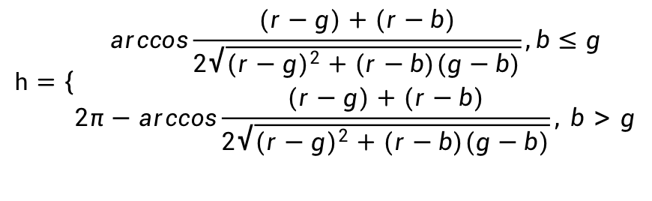
Color descriptors
RGB to HSV:
$$h=\left\{\begin{aligned}arccos\frac{(r−g)+(r−b)}{2\sqrt{{(r−g)}^{2}+(r−b)(g−b)}},b≤g \\ 2π−arccos\frac{(r−g)+(r−b)}{2\sqrt{{(r−g)}^{2}+(r−b)(g−b)}}, b>g\end{aligned}\right.$$
$$s=\frac{max(r, g, b)−min(r, g, b)}{max(r, g, b)}$$
$$v=\frac{max(r, g, b)}{255}$$
$$H∈[0°, 360°], S∈[0, 1], V∈[0, 1]$$

Slide 44
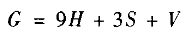
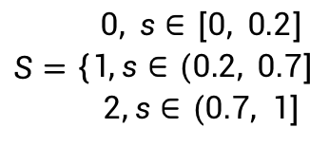
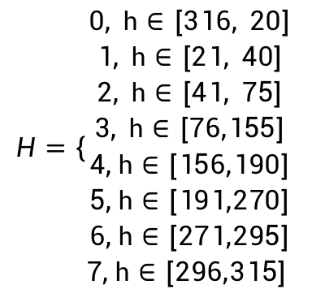
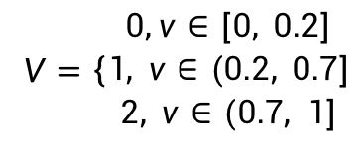
Color descriptors
We can find from the HSV space:
Hue: [21, 40]->Orange，[41, 75] ->Yellow, [76, 155] ->Green, [156, 190] ->Cyan, [191, 270] ->Blue, [271, 295] ->Purple, [296, 315] ->Magenta, [316, 20] ->Red.
Saturation: [0, 0.2] -> human eye cannot identify hue, appear to gray, (0.2, 0.7]->we can see color, (0.7, 1]->Hue keeps slight changes.
Value: [0, 0.2] -> appear to black, (0.2, 0.7]->noted the changes, (0.7, 1]->appear to white.
$$H=\left\{\begin{aligned}0, h∈[316, 20] \\ 1, h∈[21, 40] \\ 2, h∈[41, 75] \\ 3, h∈[76,155] \\ 4,h∈[156,190] \\ 5,h∈[191,270] \\ 6,h∈[271,295] \\ 7,h∈[296,315] \end{aligned}\right.$$
$$S=\left\{\begin{aligned}0, s∈[0, 0.2] \\ 1,s∈(0.2, 0.7] \\ 2,s∈(0.7, 1]\end{aligned}\right.$$
$V=\left\{\begin{aligned}0,v∈[0, 0.2] \\ 1, v∈(0.2, 0.7] \\ 2, v∈(0.7, 1]\end{aligned}\right.$

Slide 45
Color descriptors
function F2=colorFXhist6(x)
H=x(:,:,1); S=x(:,:,2); V=x(:,:,3);
[m,n]=size(H); N=m*n;
t1=1/18; t2=1/9; t3=75/360; t4=155/360; t5=190/360; t6=270/360; t7=295/360;
t8=315/360;
for i=1:m
for j=1:n
if H(i,j)<=t1 | H(i,j)>t8
h_bin=0;
elseif t1<H(i,j) & H(i,j)<=t2
h_bin=1;
elseif t2<H(i,j) & H(i,j)<=t3
h_bin=2;
elseif t3<H(i,j) & H(i,j)<=t4
h_bin=3;
elseif t4<H(i,j) & H(i,j)<=t5
h_bin=4;
elseif t5<H(i,j) & H(i,j)<=t6
h_bin=5;
elseif t6<H(i,j) & H(i,j)<=t7
h_bin=6;
elseif t7<H(i,j) & H(i,j)<=t8
h_bin=7;
end
if S(i,j)>=0 & S(i,j)<=0.2
s_bin=0;
elseif 0.2<S(i,j) & S(i,j)<=0.7
s_bin=1;
elseif S(i,j)>0.7
s_bin=2;
end
if V(i,j)>=0 & V(i,j)<=0.2
v_bin=0;
elseif 0.2<V(i,j) & V(i,j)<=0.7
v_bin=1;
elseif V(i,j)>0.7
v_bin=2;
end
F(h_bin*9+s_bin*3+v_bin+1)=F(h_bin*9+s_bin*3+v_bin+1)+1;
end
end
F2=F/N;

Slide 46
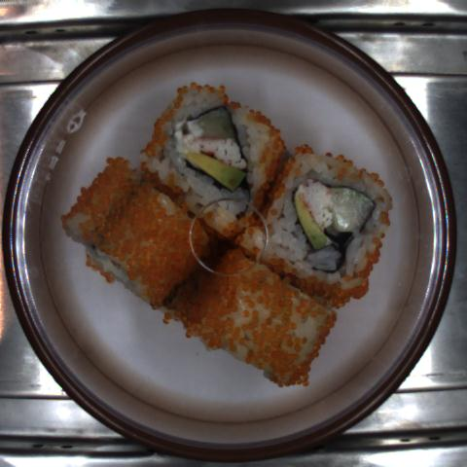





Color descriptors
测试样本总数 | 正确识别数 | 精度
863 | 838 | 97.1%

Slide 47
Color descriptors
颜色矩
1995年Stricker基于颜色的相似性提出了一种简单有效的颜色特征表示方法——颜色矩，与颜色直方图相比，该方法不需要量化颜色空间且特征向量维数低。颜色矩能够全面呈现图像的颜色分布特征，在图像检索与识别中常用的颜色矩主要包括:
描述平均颜色的一阶矩
描述颜色标准差的二阶矩
描述颜色的偏斜性的三阶矩

Slide 48

Color descriptors
假设颜色模型对应的三分量为$\text{i}$ ($\text{i}$=1, 2, 3)，像素点个数为N。
颜色一阶矩定义如下：
式中， ${\text{p}}_{\text{ij}}$为颜色分量i对应第j个像素的灰度值。
颜色二阶矩定义为：
颜色三阶矩定义如下：
依此类推可定义更高阶的颜色矩，但高阶矩通常需要更多信息才能获得对其值的良好估计，因此在实际应用中，一般1-3级低阶矩已足够描述图像特征。

Slide 49

Color descriptors
因为颜色矩与像素位置无关，所以颜色矩也具有旋转、平移不变性，此外，颜色矩对缩放变换不敏感。以图分辨率为1000×750的郁金香彩色图像为例，将图像缩小一半至500×375，然后分别计算缩放前后图像RGB、HSV、Lab和YCrCb四种颜色模型对应的一阶矩、二阶矩和三阶矩，实验结果下表所示，从表中可以看出，缩放前后各颜色模型对应的颜色矩变化很小，所以颜色矩具备缩放不变性。
颜色矩 颜色模型 | 一阶矩 |  |  | 二阶矩 |  |  | 三阶矩
 | E₁ | E₂ | E₃ | σ₁ | σ₂ | σ₃ | s₁ | s₂ | s₃
RGB | 93.9/93.8 | 102.6/102.4 | 137.1/136.8 | 64.3/65.5 | 51.9/53.6 | 73.8/74.7 | 72.9/74.2 | 58.7/60.5 | 80.3/81.1
HSV | 75.9/76.4 | 113.9/115.3 | 142.8/142.6 | 68.5/68.5 | 44.7/46.9 | 71.2/72.1 | 72.4/72.3 | 52.0/54.4 | 77.7/78.6
Lab | 119.1/118.8 | 139.6/139.5 | 139.9/139.9 | 56.2/57.6 | 23.9/24.1 | 10.9/11.1 | 63.1/64.5 | 26.8/27.0 | 12.3/12.5
YCrCb | 111.9/111.7 | 146.0/145.9 | 117.8/117.9 | 55.8/57.2 | 23.6/23.8 | 9.3/9.5 | 62.7/64.2 | 27.1/27.4 | 10.6/10.8
郁金香图像缩放前后(用“/”区分)不同颜色分量对应的颜色矩

Slide 50
Color Histogram Usage
颜色聚合向量(CCV)
颜色直方图和颜色矩虽然具备良好的旋转、平移不变性，但存在无法表达图像空间位置关系的缺点，因此Pass等在1997年提出了颜色聚合向量（Color Coherence Vector）的概念。Pass等根据图像中颜色相似的像素值是否在某一连续区域存在聚合这一特性，定义满足条件的像素为聚合像素，不满足条件的像素为非聚合像素，而颜色聚合向量为图像中不同量化级别下聚合像素与非聚合像素的分布关系提供了一种特征描述。因此，颜色聚合向量可防止图像中颜色相似的聚合像素与非聚合像素的误匹配，从而有效实现图像空间位置关系的表达。
CCV是一种将颜色信息编码成向量的技术，通过将颜色划分成若干个区域，并将每个区域编码成向量，从向量间的距离来度量颜色的相似性。

Slide 51
Color Histogram Usage
颜色聚合向量的计算步骤如下：
1. 图像模糊与图像量化
首先通过高斯模糊算法将像素值替换为局部邻域（如8领域）中的平均值，从而消除相邻像素之间的细微差异，然后分别对颜色模型的各分量进行量化，使得图像中仅含有n种不同的像素值。假设有一幅30个灰度级的图像，如图(a)和(b)所示，按照[0, 10)、[10, 20)、[20, 30)区间划分进行三级量化，量化后的图像将仅含3种不同的像素值。
12 | 0 | 1 | 22 | 5 | 6
14 | 11 | 3 | 20 | 4 | 7
13 | 7 | 28 | 23 | 7 | 6
15 | 15 | 12 | 4 | 5 | 11
17 | 12 | 2 | 1 | 11 | 10
14 | 11 | 0 | 2 | 12 | 13
2 | 1 | 1 | 3 | 1 | 1
2 | 2 | 1 | 3 | 1 | 1
2 | 1 | 3 | 3 | 1 | 1
2 | 2 | 2 | 1 | 1 | 2
2 | 2 | 1 | 1 | 2 | 2
2 | 2 | 1 | 1 | 2 | 2
A | B | B | C | D | D
A | A | B | C | D | D
A | B | C | C | D | D
A | A | A | D | D | E
A | A | D | D | E | E
A | A | D | D | E | E
(a) 像素位置及灰度值
(b) 3级量化结果
(c) 连通分量计算结果
图像量化与连通分量计算示意图

Slide 52


Color Histogram Usage
2. 计算连通分量
根据量化的颜色值在图像空间的位置计算连通分量，图(c)所示，在考虑8邻域情况下，通过计算连通分量，原图像将变成含有A、B、C、D、E五个连通区域的图像。
2 | 1 | 1 | 3 | 1 | 1
2 | 2 | 1 | 3 | 1 | 1
2 | 1 | 3 | 3 | 1 | 1
2 | 2 | 2 | 1 | 1 | 2
2 | 2 | 1 | 1 | 2 | 2
2 | 2 | 1 | 1 | 2 | 2
3. 划分聚合与非聚合像素
根据连通图可将像素划分为聚合与非聚合像素，类似于直方图，首先统计各连通分量中像素的个数$\text{x}$，若像素${\text{p}}_{\text{i}}$对应的某连通分量C_{j}的像素个数超过某一阈值$\text{τ}$，即$\text{x}\text{>}\text{τ}$，则该像素是聚合像素；反之，若$\text{x}\text{≤}\text{τ}$，则该像素是非聚合像素。
A | B | B | C | D | D
A | A | B | C | D | D
A | B | C | C | D | D
A | A | A | D | D | E
A | A | D | D | E | E
A | A | D | D | E | E
根据图(c)所示连通分量计算可得包含（ 像素量化值，连通分量标记，像素个数）的三元组分别为：(1, B, 4)、(1, D, 12)、(2, A, 11)、(2, E, 5)、(3, C, 4)。令$\text{τ}$=4，则划分后的聚合像素集合为：(1, D, 12)、(2, A, 11)、(2, E, 5)；非聚合像素集合为：(1, B, 4)、(3, C, 4)。

Slide 53



Color Histogram Usage
4. 生成颜色聚合向量
设${\text{α}}_{\text{i}}$、 ${\text{β}}_{\text{i}}$分别表示量化后第$\text{i}$种颜色对应聚合像素和非聚合像素的累加数量，则(${\text{α}}_{\text{i}} \text{,}$ ${\text{β}}_{\text{i}}$)构成了第i种颜色的聚合对，该图像的聚合向量可表示为：
< (${\text{α}}_{\text{1}} \text{,}$ ${\text{β}}_{\text{1}}$), (${\text{α}}_{\text{2}} \text{,}$ ${\text{β}}_{\text{2}}$), …, (${\text{α}}_{\text{i}}\text{ ,}$ ${\text{β}}_{\text{i}}$), …, (${\text{α}}_{\text{n}} \text{,}$ ${\text{β}}_{\text{n}}$) >。
因此，图c生成的聚合向量可表示为<(12, 4), (16, 0), (0, 4)>。
5. 定义一个距离方程
计算两个聚合向量之间的距离，来度量任意两个图像之间的差异。例如：
图像1的CCV为： < (${\text{C}}_{\text{1}} \text{,}$ ${\text{N}}_{\text{1}}$), (${\text{C}}_{\text{2}} \text{,}$ ${\text{N}}_{\text{2}}$), …, ${\text{C}}_{\text{n}} \text{,}$ ${\text{N}}_{\text{n}}$) >
图像2的CCV为：< (${\text{c}}_{\text{1}} \text{,}$ ${\text{n}}_{\text{1}}$), (${\text{c}}_{\text{2}} \text{,}$ $n_{\text{2}}$), …, ${\text{c}}_{\text{n}} \text{,}$ ${\text{n}}_{\text{n}}$) >

Slide 54




Color Histogram Usage
以分辨率为1000×750的郁金香彩色图像为例，提取该图像的R分量并进行级别为8的量化，然后计算连通分量，设定$τ\text{= 0.01×1000×750 = 7500}$，基于此阈值划分聚合与非聚合像素集合后生成的颜色聚合向量下表所示，从表中可以发现，像素值在[32, 128)和[224, 256)两个区间的颜色聚集最显著，对应的聚合向量分布图如右图。
颜色区间 | [0, 32) | [32, 64) | [64, 96) | [96, 128) | [128,160) | [160,192) | [192,224) | [224,256)
$${\text{α}}_{\text{i}}$$ | 0 | 11438 | 8717 | 38267 | 0 | 0 | 0 | 53529
$${\text{β}}_{\text{i}}$$ | 15920 | 113792 | 108258 | 104826 | 83495 | 50073 | 61846 | 99839
Notes:
原图、基于郁金香量化图像计算的连通区域图、量化级别为8时对应的聚合向量分布图

Slide 55
Color Histogram Usage
Color histograms provide a concise but coarse characterization of an image
Often used in CBIR (content based image retrieval) systems
Large database of images which can be searched by image content, not by keyword
Use color histograms to refine the search
Similar histograms are likely to reflect visually similar source images
Two very dissimilar source images may have two similar histograms

Slide 56
Summary
We have looked at:
Boundary descriptor
Region descriptor
Relational descriptor

